Slide 1
GOODS PURCHASED UNDER NHP DURING FY2018-2019
Activity Name | Remarks
1. Renovation of Existing C.E Building(Wall & AC) | Completed
2. Sound System for Committee Room | Completed
3. Purchase of Water Cooler | Completed
4. Purchase of AC | Completed
5. IT Equipment for Data Centre - Workstation, Scanner, Internet facilities, Mini Ups - Desktop Computer - Photocopier - Printer - 3Kva online UPS - Display unit for Video Conference Room - Tables and chairs for Video Conference room | Completed
6. DG set for power backup | Completed

Slide 2
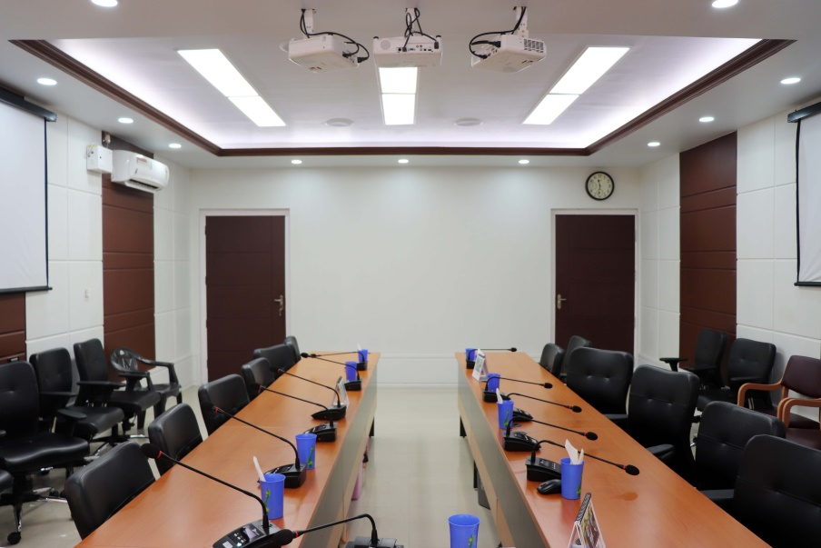
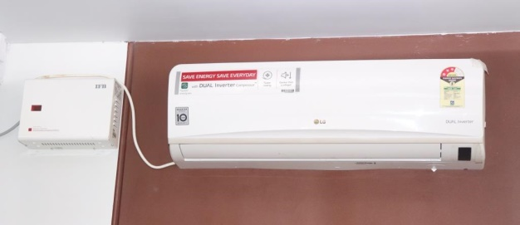
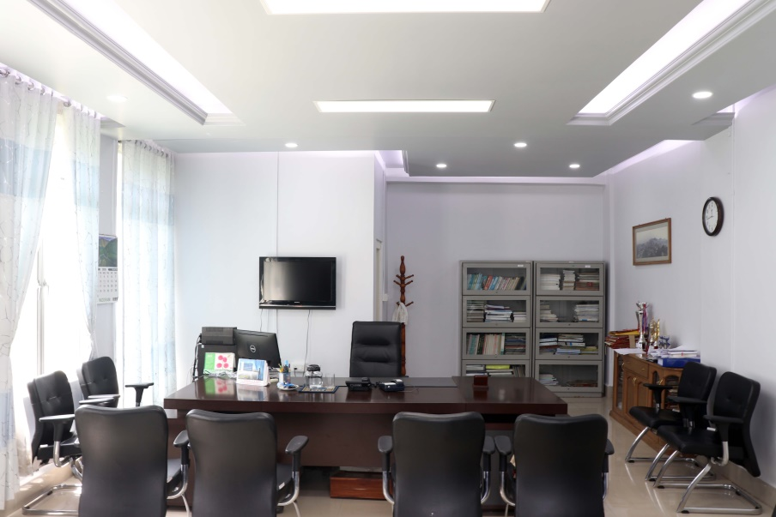
RENOVATION OF EXISTING CE BUILDING
Wall & AC-4nos.
Amount
Rs5,90,824

Slide 3
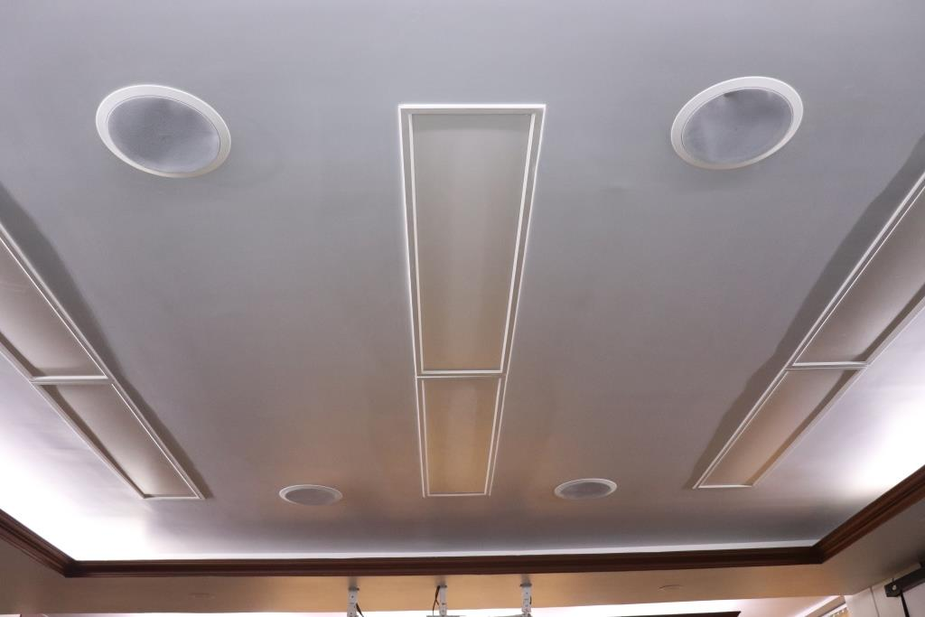
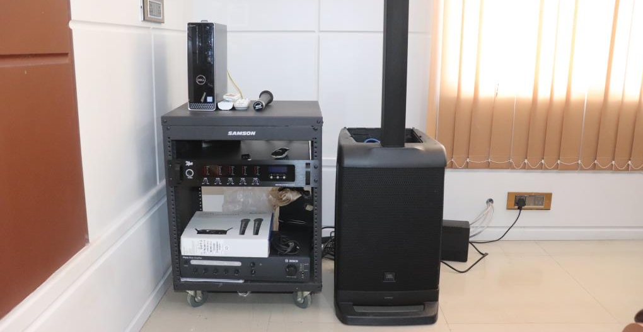
SOUND SYSTEM FOR COMMITTEE ROOM
Amount
Rs 4,45,204

Slide 4
WATER COOLER
(3 Nos)
Amount
Rs 1,43,400

Slide 5
AIR CONDITIONER
(8 Nos)
Amount
Rs 5,43,820

Slide 6
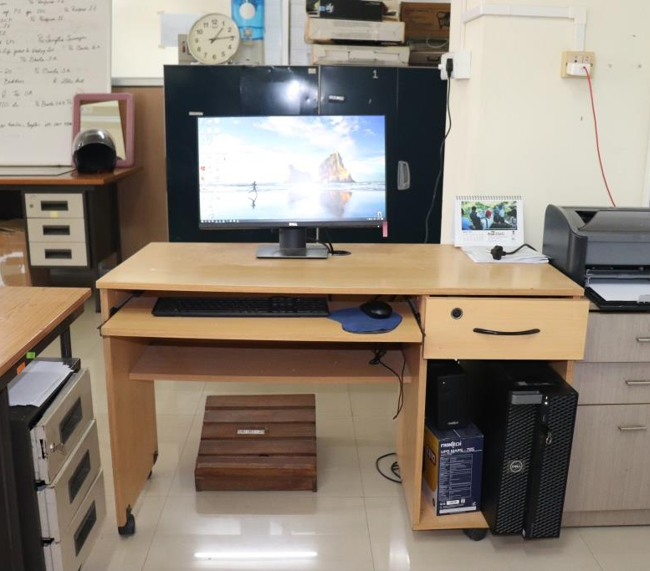
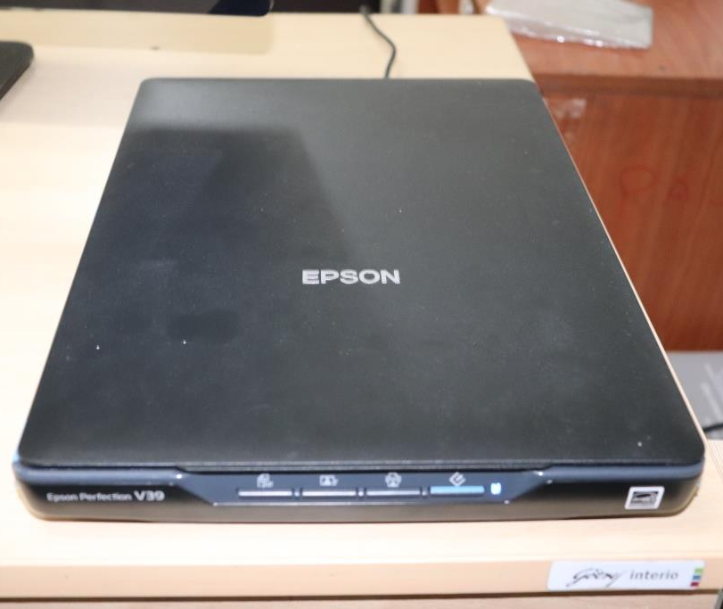
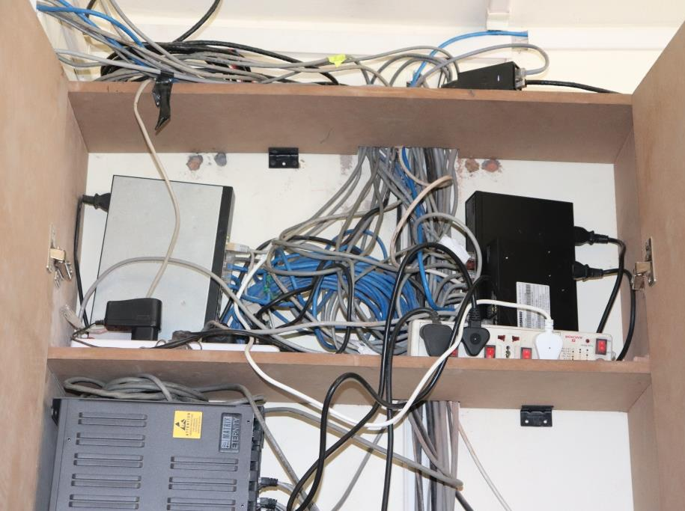
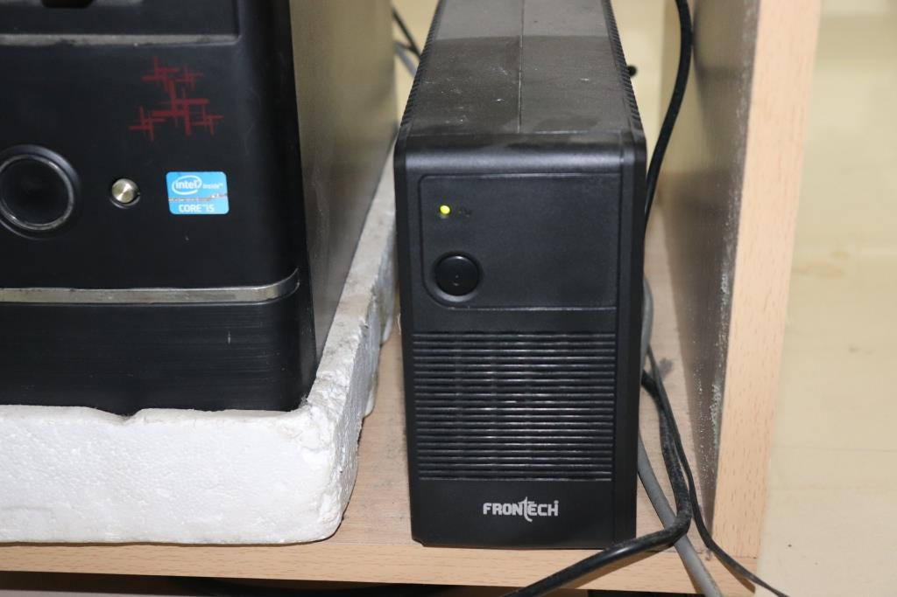
IT EQUIPMENT FOR DATA CENTRE
-
Workstation -1
Scanner – 1
Internet Facilities -1
Mini UPS – 20
Amount
Rs 4,09,400

Slide 7
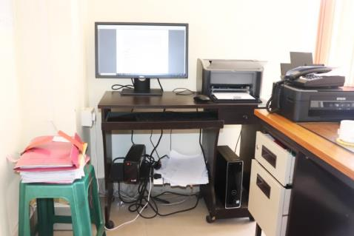
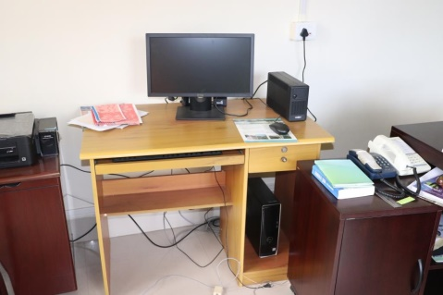
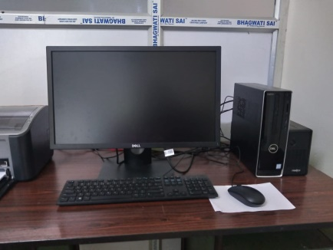
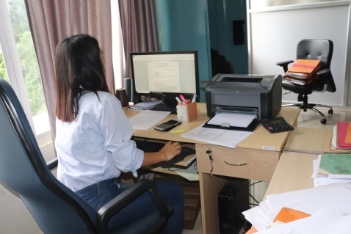
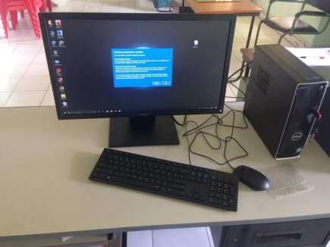
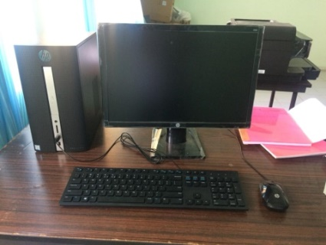
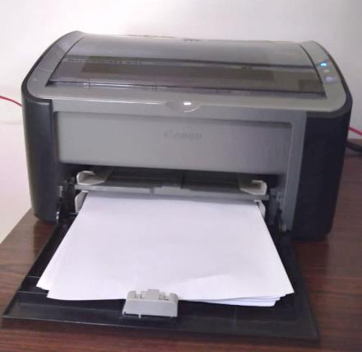
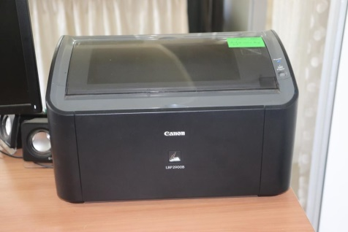
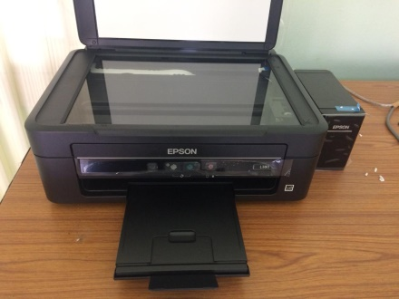
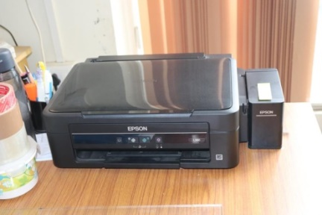
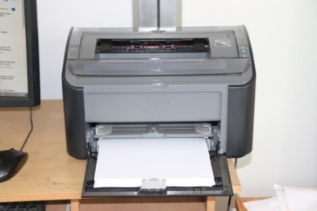
IT EQUIPMENT FOR DATA CENTRE
-
Desktop Computer – 13nos
Amount
Rs 6,77,000
Laser Printer – 9nos
Color Printer - 9nos
Total – 18nos
Amount
Rs 2,07,000

Slide 8
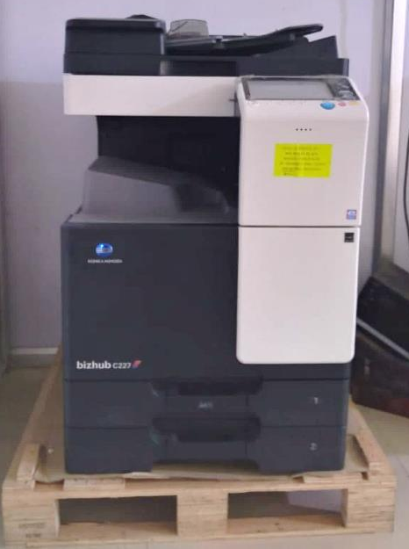
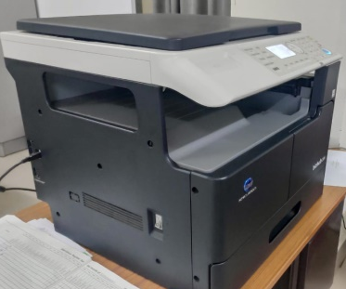
IT EQUIPMENT FOR DATA CENTRE
-
Photocopier
Color – 5nos
Black & White – 2nos
Amount
Rs 1,334,500

Slide 9
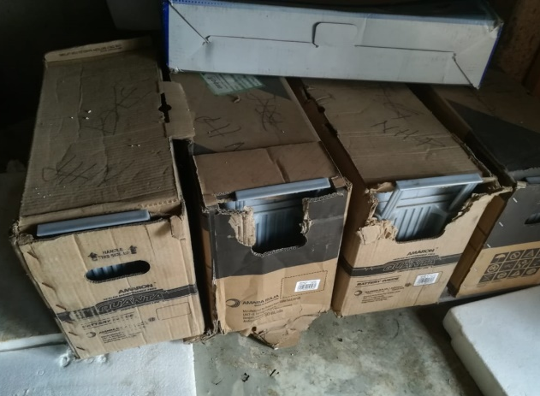
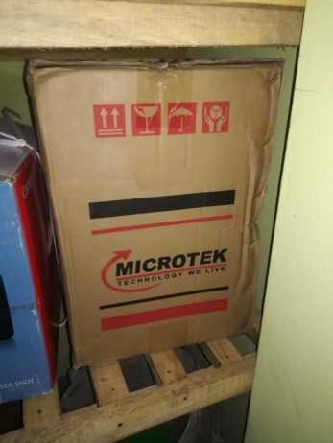
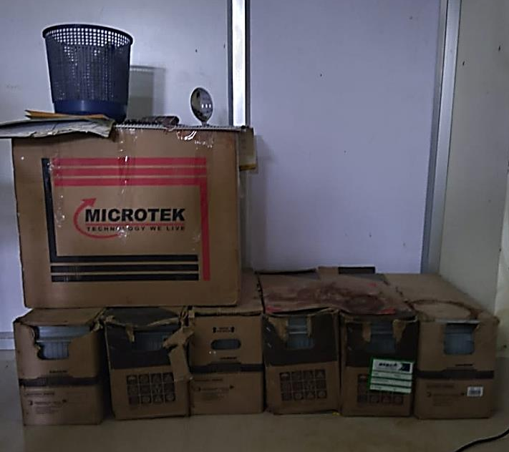
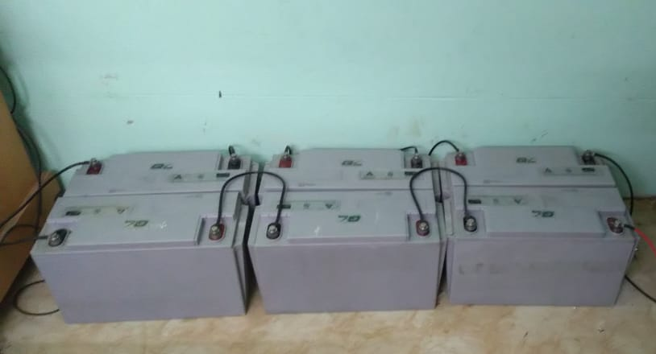
IT EQUIPMENT FOR DATA CENTRE
-
3Kva online UPS – 4nos
Amount
Rs 5,30,328

Slide 10
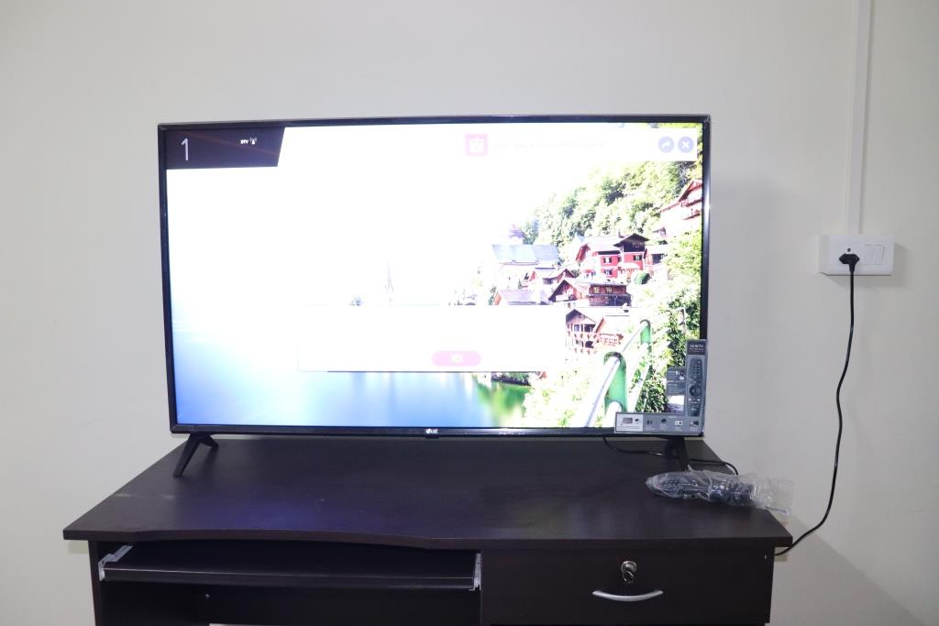
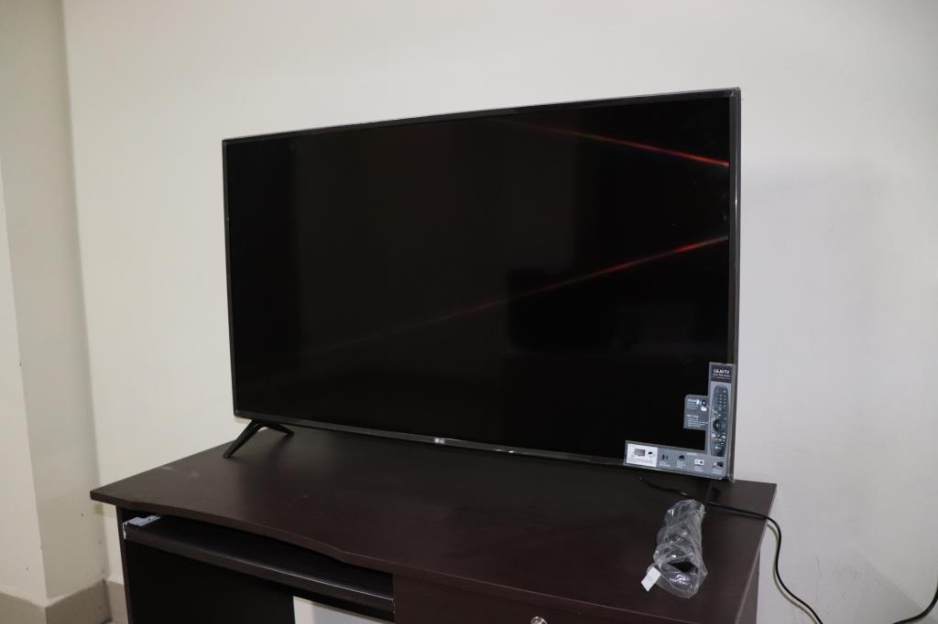
IT EQUIPMENT FOR DATA CENTRE
-
Display Unit for Video Conference Room – 2 nos
Amount
Rs 1,75,800

Slide 11
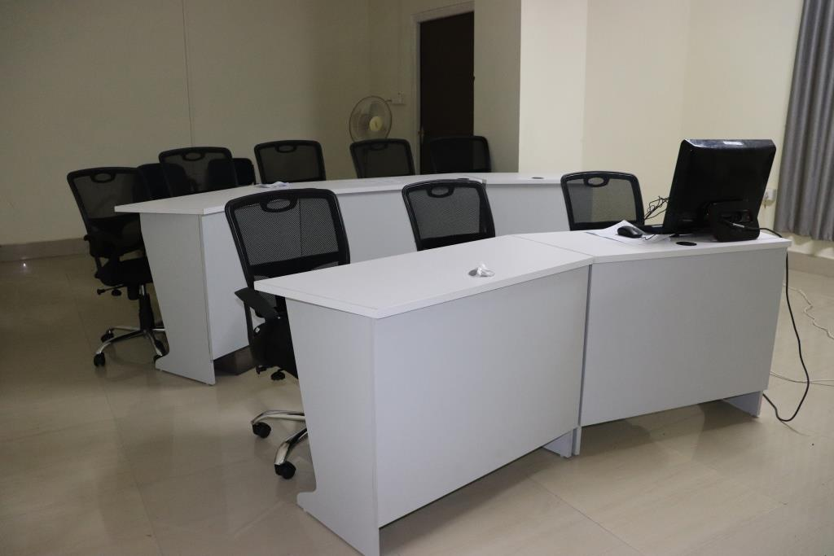
IT EQUIPMENT FOR DATA CENTRE
-
Video Conference Room
Tables (5nos)
Compt.Table (1no)
Chairs (9nos)
Amount
Rs 1,67,090

Slide 12
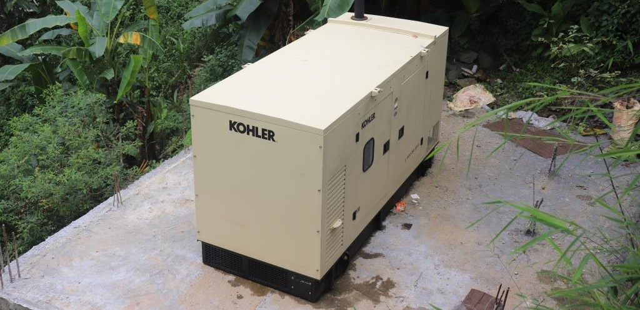
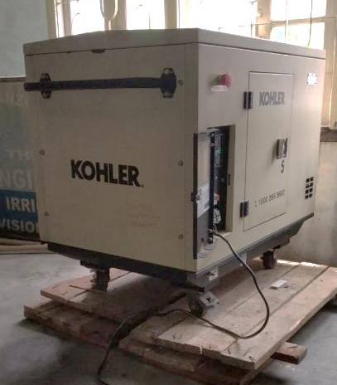
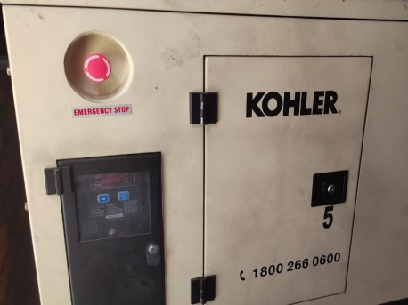
DG SET FOR POWER BACKUP
100kVA – 1 no
Amount
Rs 11,97,700
5kVA – 3 no
Amount
Rs 7,73,844

